Slide 1
Test Management Process in Software Testing

Slide 2
Test Management
Test Management is a process of managing the testing activities in order to ensure high quality and high-end testing of the software application.
The method consists of organizing, controlling, ensuring traceability and visibility of the testing process in order to deliver a high-quality software application.
It ensures that the software testing process runs as expected.

Slide 3
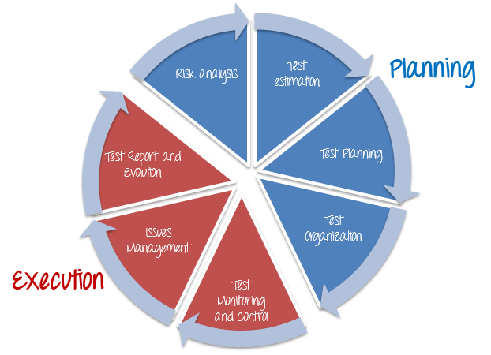
Test Management Phases
There are two main parts of Test Management Process: –
Planning
Risk Analysis
Test Estimation
Test Planning
Test Organization
Execution
Test Monitoring and Control
Issue Management
Test Report and Evaluation

Slide 4
Test Management Process
Test Management Process is a procedure of managing the software testing activities from start to end.
The test management process provides planning, controlling, tracking, and monitoring facilities throughout the whole project cycle.
The process involves several activities like test planning, designing, and test execution.
It gives an initial plan and discipline to the software testing process.

Slide 5
Planning

Slide 6
Risk Analysis and Solution
Risk is the potential loss (an undesirable outcome, however not necessarily so) resulting from a given action or an activity.
Risk Analysis is the first step that Test Manager should consider before starting any project.
Because all projects may contain risks, early risk detection and identification of its solution will help Test Manager to avoid potential loss in the future & save on project costs.

Slide 7
Test Estimation
An estimate is a forecast or prediction.
Test Estimation is approximately determining how long a task would take to complete.
Estimating effort for the test is one of the major and important tasks in Test Management.
Benefits of correct estimation:
Accurate test estimates lead to better planning, execution, and monitoring of tasks under a test manager’s attention.
Allow for more accurate scheduling and help realize results more confidently.

Slide 8
Test Planning
A Test Plan can be defined as a document describing the scope, approach, resources, and schedule of intended Testing activities.
A project may fail without a complete Test Plan.
Test planning is particularly important in large software system development.
In software testing, a test plan gives detailed testing information regarding an upcoming testing effort, including:
Test Strategy
Test Objective
Exit /Suspension Criteria
Resource Planning
Test Deliverables

Slide 9
Test Organization
Test Organization in Software Testing is a procedure of defining roles in the testing process.
It defines who is responsible for which activities in the testing process.
The same process also explains test functions, facilities, and activities.
The competencies and knowledge of the people involved are also defined.
However, everyone is responsible for the quality of the testing process.

Slide 10
Execution

Slide 11
Test Monitoring and Control
Test Monitoring and Control is the process of overseeing all the metrics necessary to ensure that the project is running well, on schedule, and not out of budget.
Monitoring
Monitoring is a process of collecting, recording, and reporting information about the project activity that the project manager and stakeholder needs to know
To Monitor, Test Manager does the following activities
Define the project goal, or project performance standard
Observe the project performance, and compare the actual and the planned performance expectations
Record and report any detected problem which happens to the project
Controlling
Project Controlling is a process of using data from monitoring activity to bring actual performance to planned performance.
In this step, the Test Manager takes action to correct the deviations from the plan. In some cases, the plan has to be adjusted according to project situation.

Slide 12
Issue Management
All projects may have potential risks. When the risk happens, it becomes an issue.
In the life cycle of any project, there will be always unexpected problems and questions that crop up. For example:
The company cuts down your project budget
Your project team lacks the skills to complete the project
The project schedule is too tight for your team to finish the project at the deadline.
Risks to be avoided while testing:
Missing the deadline
Exceed the project budget
Lose the customer’s trust
When these issues arise, you have to be ready to deal with them – or they can potentially affect the project’s outcome.

Slide 13
Test Report & Evaluation
The purpose of the Test Evaluation Reports is:
“Test Evaluation Report” describes the results of the Testing in terms of Test coverage and exit criteria. The data used in Test Evaluation are based on the test results data and test result summary.

